Slide 1
Object Oriented Programming using Java (ECSE102L)

Slide 2
Outline
Class
Variable
Object
Creating an Object
Initializing an Object

Slide 3
Class
S
A class is mainly a user defined blueprint to create any object.
A Java program consists of one or more classes.
It is the abstract descriptions of objects.
Declaration of a Class includes some components:
  Modifiers
  Class name
  Superclass (optional)
  Interfaces (optional)
  Body

Slide 4
Class (Cont…)
S
Example
public class Cat
{
String name;
int age;
String color;
void barking()
{
}
void sleeping()
{
}
void hungry()
{
}
}

Slide 5
Variable
S
There can be three variable types in a class:
  Local variables: Local variables are declared within the method. These variables are destroyed, when method is completed.
  Instance variables: Instance variables are declared within a class, but outside any method. These type of variables can be accessed from inside any method.
  Class variables: Class variables are declared within a class with the static keyword, but outside any method. If changes are made to the class variable, all other instances can see the effect of the changes.

Slide 6
Variable (Cont…)
S
Example of local variables
class Abc
{
void init()
{
int ID=101;
String Name="Suyel";
}
}
class Main
{
public static void main(String args[])
{
Abc Obj=new Abc();
System.out.println(Obj.id);
}
}
6

Slide 7
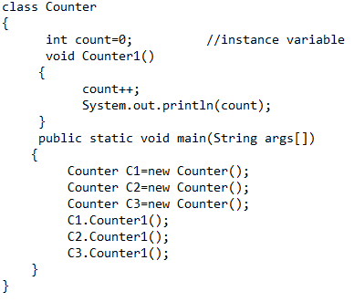
Variable (Cont…)
S
Example of instance variables

Slide 8
Variable (Cont…)
S
Example of instance variables (Cont…)
  Output
  1
  1
  1

Slide 9
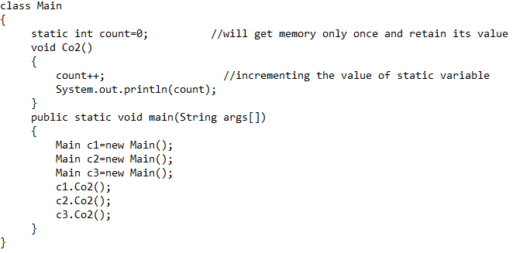
Variable (Cont…)
S
Example of class variables

Slide 10
Variable (Cont…)
S
Example of class variables (Cont…)
  Output
  1
  2
  3

Slide 11
Variable (Cont…)
S
Combination
Student.java
class Student
{
int rollno; //instance variable
String name;
static String college ="ITS"; //static variable
void Student1(int r, String n)
{
rollno = r;
name = n;
}
void display ()
{
System.out.println(rollno+" "+name+" "+college);
}
}
TestStaticVariable1.java
public class TestStaticVariable1
{
public static void main(String args[])
{
Student s1 = new Student();
Student s2 = new Student();
s1.Student1(111, Karan);
s2.Student1(222, Aryan);
s1.display();
s2.display();
}
}
11

Slide 12
Variable (Cont…)
S
Combination (Cont…)
  Output
111 Karan ITS
222 Aryan ITS

Slide 13
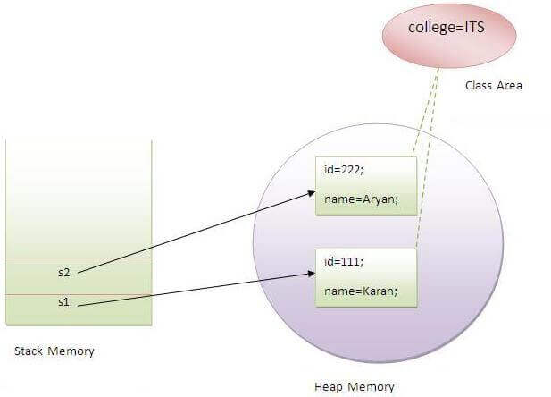
Variable (Cont…)
S

Slide 14
Object
S
An object is an instance of a class.
It is a basic unit of object oriented programming and represents the real life entities.
Object can be tangible and intangible.
Object has three characteristics:
  State: It represents the data (value) or attributes of an object.
  Behavior: It represents the behavior (functionality) of an object. It also reflects the response of an object with other objects.
  Identity: An object identity is typically implemented by an unique name to interact with other objects.

Slide 15
Object (Cont…)
S
Let us consider that Bike is an object and its name is Pulsar.
The color of the Pulsar can be Black, which is known as its state.
Pulsar is used to ride from one place to another, so riding is its behavior.

Slide 16
Object (Cont…)
S
When an object is created, the class of the object is instantiated.
“new” keyword instantiates a class and allocates new memory for objects.
All the instances share the attribute and behavior of the class. But, the values of those attributes are unique for each object.
A class can have many instances:
  Pulsar Obj1_Pulsar1 = new Pulsar()
  Pulsar Obj2_Pulsar2 = new Pulsar()
  Pulsar Obj3_Pulsar3 = new Pulsar()

Slide 17
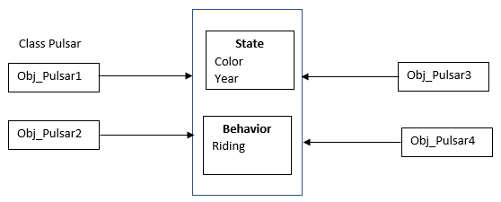
Object (Cont…)
S

Slide 18
Object (Cont…)
S
Heap Memory
Obj_Pulsar1 Obj_Pulsar2 Obj_Pulsar3 Obj_Pulsar4
Methods
Variable
Methods
Variable
Methods
Variable
Methods
Variable

Slide 19
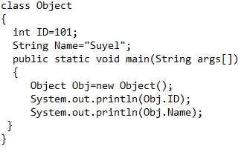
Object (Cont…)
S

Slide 20
Object (Cont…)
S
Output
101
Suyel

Slide 21
Object (Cont…)
S
class Abc
{
void init()
{
int ID=101;
String Name="Suyel";
System.out.println(ID+Name);
}
public static void main(String args[])
{
Abc Obj=new Abc();
Obj.init();
}
}

Slide 22
Object (Cont…)
S
Output
101Suyel

Slide 23
Object (Cont…)
S
Main outside the class
Object_Par.java
class Object_Par
{
int ID=101;
String Name="Suyel";
}
Object_Child.java
class Object_Child
{
public static void main(String args[])
{
Object_Par Obj=new Object_Par();
System.out.println(Obj.ID);
System.out.println(Obj.Name);
}
}
23

Slide 24
Object (Cont…)
S
Compile both the class i.e. Object_Par and Object_Child
Run Object_Child
Output
101
Suyel

Slide 25
Creating Object in a Class
S
Using “new” Keyword
  We have already gone through this keyword.
Using Class.forName(String className) method
  In java.lang package, there is a predefined class with name “Class”.
  The forName(String className) method returns the Class object that is associated with the class with the given string name.
  When we call by using “new Instance()” method, it returns new instance of the class with the given string name.
Hello obj_Clfr= (Hello)Class.forName(“Bennett.Hello").newInstance();
  Here, we have created a object of class Hello and class Hello is presented in package Bennett.

Slide 26
Creating Object in a Class (Cont…)
S
Using clone() method
  It creates and returns a copy of the object.
  class Object_Clone implements Cloneable
  {
  int ID=101;
  public static void main(String args[]) throws CloneNotSupportedException
  {
  Object_Clone Obj=new Object_Clone();
  Object_Clone Obj_1=(Object_Clone)Obj.clone();
  }
  }

Slide 27
Creating Object in a Class (Cont…)
S
Creating multiple objects by one type
  It is most popular.
  Normally, different objects of a class is required in many methods. So, we create a reference and use it as per our requirements.
  Memory wastage is less.
  Hello multiple; //reference variable
  multiple = new Hello(); //object creation

Slide 28
Initialization of an Object
S
There are three ways to initialize an object:
  Initialization through reference
  Initialization through method
  Initialization through a constructor

Slide 29
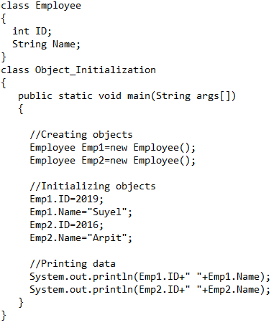
Initialization Through Reference
S
We can create multiple objects and store information in it through reference variable.

Slide 30
Initialization Through Reference (Cont…)
S
Output
2019 Suyel
2016 Arpit

Slide 31
Initialization Through Method
S
A method is a block of code, which only runs when it is called.
We can pass data known as parameters/arguments into a method.
Method is used to perform certain actions.
A method defines the behavior of any object.
It defines an interface to expose the state of an object.

Slide 32
Initialization Through Method (Cont…)
S
Why we use method?
  To reuse code: It defines the code once and we can use the same code (method) many times.
All the methods are defined within the class.
Java provides some pre-defined methods, such as println(), print(), main(), etc.
We can also create our own method to perform certain actions.
  <Access Specifier> <Return Type> <Method Name> (arguments)
  {
  Statements or behavor;
  return <Variable Name> //return is used, when there is a return
  }

Slide 33
Initialization Through Method
S
Why we use method?
  To reuse code: It defines the code once and we can use the same code (method) many times.
All the methods are defined within the class.
Java provides some pre-defined methods, such as println(), print(), main(), etc.
We can also create our own method to perform certain actions.
  <Access Specifier> <Return Type> <Method Name> (arguments)
  {
  Statements or behavor;
  return <Variable Name> //return is used, when there is a return
  }

Slide 34
Initialization Through Method (Cont…)
S
Modifier: It defines access type of the method i.e. from where it can be accessed in the application. There are 4 types of access specifiers in Java:
  public: accessible in all the class in the application.
  protected: accessible within the class in which it is defined and in its subclass.
  private: Hide accessible only within the class in which it is defined.
  default (declared/defined without using any modifier): accessible within same class and package within which its class is defined.
The return type : The data type of the value returned by the method or void, if does not return a value.

Slide 35
Initialization Through Method (Cont…)
S
Method Name: A method has a unique name within the class in which it is defined. However, a method might have the same name as other method names within the same class because Java supports method overloading.
Parameter List: Comma separated list of the input parameters are defined, preceded with their data type, within the enclosed parenthesis. If there are no parameters, we must use empty parentheses ().
Method Body: The code or operation that we need to execute.

Slide 36
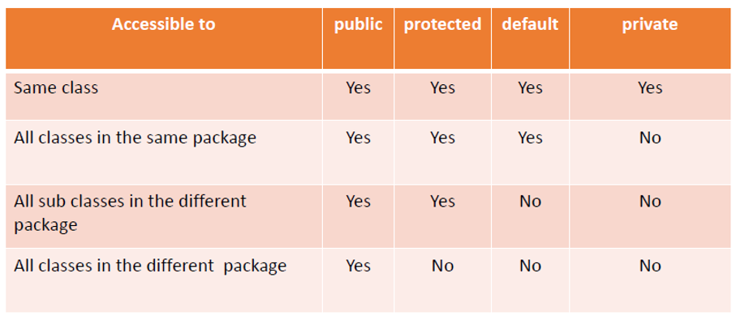
Initialization Through Method (Cont…)
S
Access Specifier

Slide 37
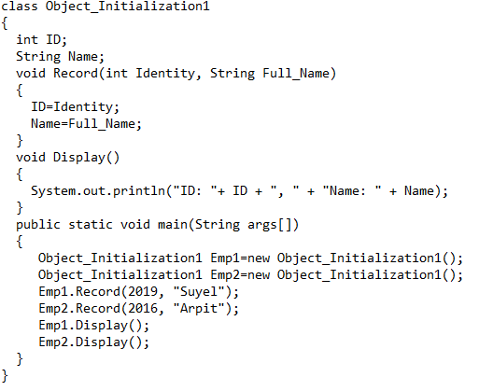
Initialization Through Method (Cont…)
S

Slide 38
Initialization Through Method (Cont…)
S
Output
  ID: 2019, Name: Suyel
  ID: 2016, Name: Arpit

Slide 39




